Slide 1
Supply Chain Actor Mapping Report
The Mukdahan Corridor across Thailand, Laos and Vietnam
Part 3 – Vietnam Report
December 2010

Slide 2
Vietnam Report
Huong Hoa is a suburban district of Quang Tri province, Vietnam.
The terrain consists of hills and mountains.

Slide 3
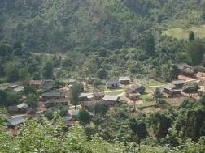
Farmers
Sector 2 farmers with 100 or more live poultry on their farm
Farmers

Slide 4
Farmers: Snapshot
Mindset
Easy-going
Simple lifestyle
Family oriented
Optimistic
Businesslike mindset
Household income
Main income does not come from poultry. They also raise pigs, have coffee plantations or have another full-time job.
Total household income from poultry is about USD $100 per month.
Livelihood Concerns
Standard of living is high compared to others in the community. Enjoy a stable income and are highly satisfied.
Family Situation
Extended families live together in one household.
Farmers

Slide 5
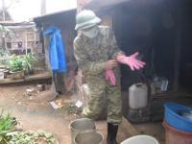
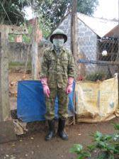
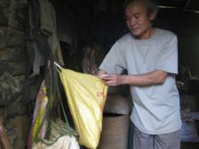
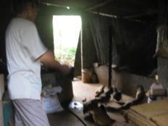
Poultry Management
Biosecurity
Biosecurity level is linked to level of education
Farmers with more education put more effort into biosecurity. They follow strict practices including wearing face masks and protective clothing, avoiding direct contact with live poultry, and disinfecting pens every 2-3 days.
Farmers with a lower level of education do not take many precautions. They practice some safety measures to avoid disease transmission but do not focus on prevention.
Smoking when feeding the poultry
Farmers

Slide 6
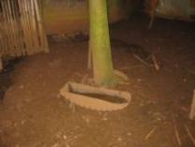
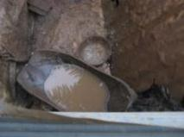
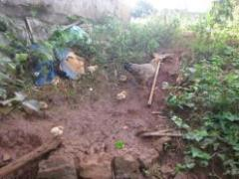
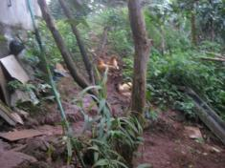
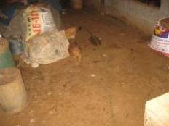
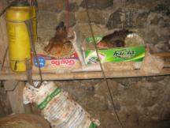
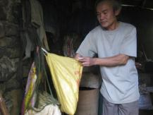
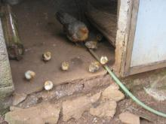
Vulnerable Areas
Low Biosecurity
Dirty feeding bowls
Chickens roam freely
Chicks not separated from adult chickens
Area for raising poultry is not kept clean
No protective clothing while feeding poultry
Farmers

Slide 7
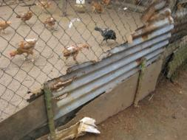
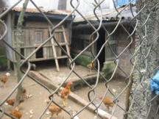
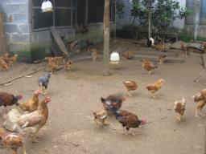
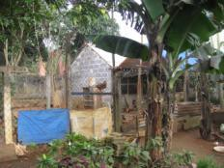
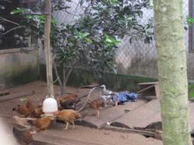
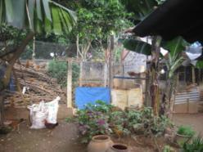
Vulnerable Areas
Moderate to high bio-security
Fenced area for raising chickens
Clean feeding bowls
Possible for chickens to escape or wild birds to fly in
Farmers

Slide 8
Hierarchy of Needs: Position of Farmers
Aspirations of Farmers
Commercial farmers in this region were found to have high aspirations.
Although most of their income comes from other jobs, they raise live poultry in their free time as an additional source of income.
Extra income is desired in case of emergency or for children’s education.
They strive to improve their status in the community.
SA
Esteem
Social Needs
Safety Needs
Physiological Needs
*SA=Self Actualisation
Farmers

Slide 9
Health Concerns of Farmers
Cancer is the leading health concern of farmers. They consider it a fatal disease, caused by harmful chemicals in foods and beverages. They believe that cancer is incurable and fatal.
Other health concerns were referred to as normal diseases, such as common flu or cold. These diseases occur more frequently and can interfere with work and school.
No. 1
Cancer
No. 2
Flu or Cold
Farmers

Slide 10
Relationship of AI to other Major Concerns
Education for successful
Career
The farmers’ highest concern is education for their children in the hopes of preparing them for a successful career.
Health is the next highest concern. A healthy family results in fewer serious illnesses. AI is spontaneously recalled by those farmers who exhibit higher biosecurity. Farmers with low biosecurity are not concerned about AI.
Household income is the lowest concern. Farmers believe that access to education and having good health, allows them to earn enough money.
Social concerns were not mentioned.
Health
AI
Economic
Social
Farmers

Slide 11
Health Belief Model (HBM)
Farmers with lower education level are at the 3rd level of the HBM: Exhibiting misguided beliefs
These farmers do not consider AI a risk because:
the government provides AI vaccinations.
if an outbreak occurs, the farmer will keep his poultry in cages and will not allow them to roam freely.
if chickens are kept in cages, they cannot get AI.
HBM
AI is believed to be a threat
Yes
Believe that AI can be avoided
Yes
Triggers
Recommended actions are effective
No
Misguided beliefs
Boost motivation through influencers such as NGOs, HCWs, etc.
Yes
Triggers
Ability to take recommended actions
Farmers

Slide 12
Farmers’ Perceptions About AI
Farmers in the Huong Hoa District, Quang Tri Province, are aware of the term “Bird Flu”. They understand that this is a serious disease because:
it can kill chickens, resulting in loss of income for the household
more seriously, it can be transmitted to humans.
However, they do not properly practice AI prevention because:
they do not remember a recent AI outbreak, but they recall that two farmers were affected during the epidemic in 2005.
it is believed that this epidemic originated in wild poultry
government provided vaccinations are given to chickens.
→ As a result, AI is not a serious concern among poultry farmers.
Farmers

Slide 13
Farmers’ Attitudes Towards AI Prevention
Farmers understand the risks and consequences of AI. However, due to the vaccination program and the fact that no recent outbreaks have occurred in their area, farmers do not practice necessary prevention measures against AI.
Although they practice some preventive measures (i.e. disinfecting the cages, wearing protective clothing) they do so in order to avoid other serious diseases in poultry such as congestion and Newcastle. The farmers believe that these diseases are more serious than AI because they occur more often and can potentially kill their chickens leading to economic loss.
There are few behaviors in place to prevent AI.
Farmers

Slide 14
Barriers to AI Prevention
Knowledge
A major barrier for farmers is a lack of knowledge stemming from a lack of experience with recent outbreaks.
Because there have been no recent outbreaks in the region, the risk of AI is not appreciated and there are other diseases which farmers are more concerned about.
Misguided Beliefs
There is a false sense of security from misguided beliefs.
The belief that vaccinated chickens will not become infected with AI provides peace of mind and farmers believe further biosecurity measures are not necessary.
While farmers are aware of past epidemics in wild poultry, they do not see this as a threat to farm raised poultry.
Farmers

Slide 15
Potential Triggers for Behaviour Change
Newcastle
The Newcastle disease can be a potential trigger. By promoting preventive measures against Newcastle, some protection against AI can be achieved as there are similarities between the two diseases.
Farmers

Slide 16
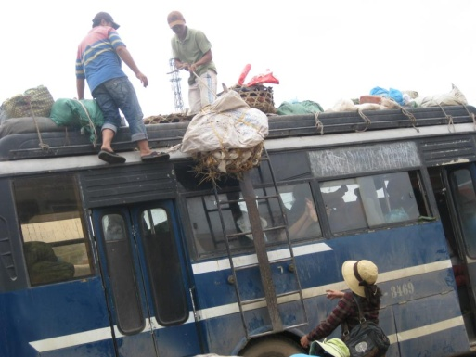
Contributors
Including wholesale egg suppliers, wholesale live poultry suppliers, transporters and vendors of live poultry
Contributors

Slide 17
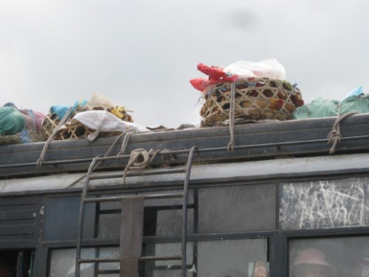
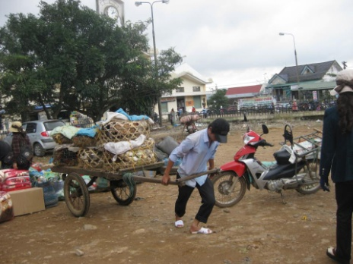
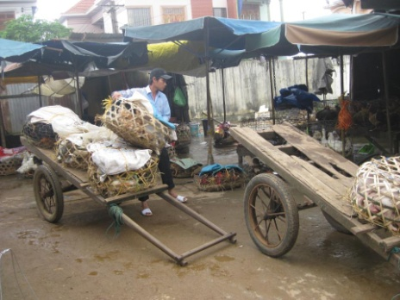
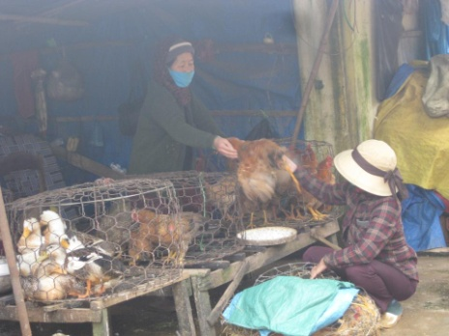
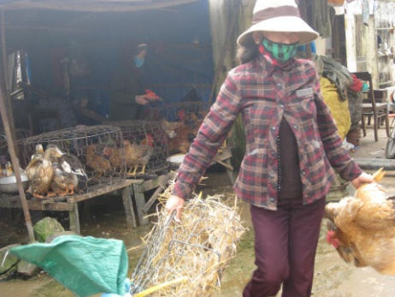
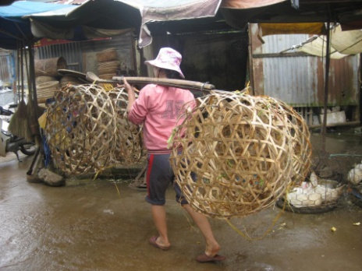
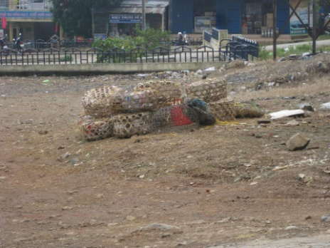
Contributors: Summary Process: Suppliers → Transporters → Vendors
Transporting poultry on buses while people are inside | The driver and his assistant are loading the poultry in crates | Carts are used to transport the crates to the poultry vendor area | Gathering the crates at the poultry vendors area in the Khe Sanh market
Middleman hands over the poultry to the vendors | Putting the empty crates aside | Carrying the crates back to the bus station | Gathering the crates in preparation for transport

Slide 18
Contributors: Snapshot
Mindset
Easy-going
Simple lifestyle
Family oriented
Optimistic
Household income
Wholesale egg suppliers, live poultry wholesale suppliers and vendors of live poultry: Main income is generated by poultry.
Transporters: Many things are transported at the same time, so poultry represents a minor percentage of their income.
Average monthly income: USD $200 - 400
Livelihood Concerns
Although they are not wealthy, they are optimistic. They are mainly concerned about household income and their financial situation.
Family Situation
Similar to farmers, extended families live together in one household.
Contributors

Slide 19
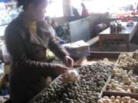
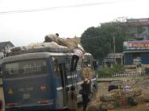
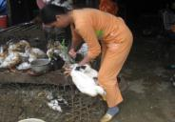
Poultry & Egg Trade
Biosecurity
Biosecurity is generally low
Wholesale egg suppliers, wholesale live poultry suppliers and vendors of live poultry: While this trade is their main income, if there were an outbreak, they are flexible and could soon be trading other goods. This results in decreased motivation towards AI prevention.
Transporters: Poultry transport is a minor percentage of their income so biosecurity is not a priority.
Contributors

Slide 20
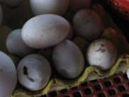
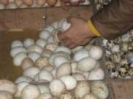
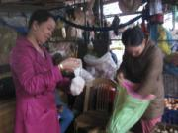
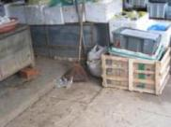
Egg suppliers –Vulnerable Areas
Suppliers do not wear protective clothing
Handling eggs without gloves
Vendors do not wear protective clothing
Spoiled and unspoiled eggs are not separated
Spoiled eggs attract flies
Cleaning tools and eggs are stored in the same place

Slide 21
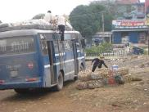
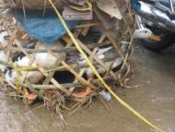
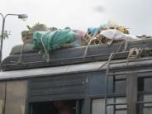
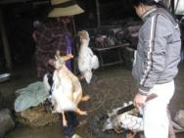
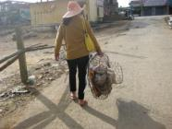
Transporters & Middlemen – Vulnerable Areas
Transporters
Middlemen
The bus is not kept clean
Poultry crates are not separated from other goods
Workers handle crates without protective clothing
Crates are often small and cramped
Workers handle poultry without protective clothing
Workers handle empty crate with bare hands

Slide 22
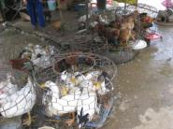
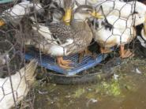
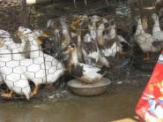
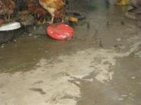
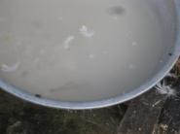
Market vendors – Vulnerable Areas
Small, cramped crates
Poultry moving around freely
Wild birds mix with the poultry
Floor not kept clean
Unclean processing utensils
Poultry not provided with fresh water and food
Attraction of many flies

Slide 23
Hierarchy of Needs: Position of Contributors
Aspirations of Contributors
The majority of contributors do not have high aspirations. They get paid daily, as they work, while farmers have a more stable source of income.
This situation leaves them with little opportunity for change and they find it difficult to aspire for something better.
Therefore, their needs are limited to basic safety to ensure a healthy family and a standard education for their children.
SA
Esteem
Social Needs
Safety Needs
Physiological Needs
*SA=Self Actualisation
Contributors

Slide 24
Health Concerns of Contributors
Contributors report similar health concerns as farmers.
Cancer is the leading health concern of contributors. They consider it a fatal disease, caused by harmful chemicals in foods and beverages. They believe that cancer is incurable and fatal.
Other health concerns were referred to as normal diseases, including common flu or cold. These diseases occur more frequently and can affect both adults and children, preventing them from working or going to school.
No. 1
Cancer
No. 2
Flu or Cold
Contributors

Slide 25
Relationship of AI to other Major Concerns
Education for successful
Career
Similar to farmers, contributors’ highest concern is that their children are educated and prepared for a successful career.
Health is also a major concern. But unlike the farmers, AI is not mentioned by most of the contributors.
Household income is the lowest concern.
Social concerns were not mentioned.
Health
Economic
AI
Social
Contributors

Slide 26
Health Belief Model (HBM)
HBM
Barriers
Communication
AI is believed to be a threat
No
Lack of experience or knowledge
Provide clear/ visual evidence of the threat of AI
Yes
Triggers
Believe that AI can be avoided
Contributors ignore the threat of AI: Lowest level of HBM
They have not experienced AI.
An outbreak may have a serious impact on their businesses but they believe they can find other work.
They trust the government quarantine system.
Yes
Triggers
Recommended actions are effective
Yes
Triggers
Ability to take recommended actions
Contributors

Slide 27
Contributors’ Perceptions About AI
Most are aware of “bird flu” from TV reports. They understand that this disease can be transmitted to humans as this has occurred in the past. However, this is not a serious concern:
“I think only big farms with hundreds of chickens may catch this AI epidemic”
“Only people coming in contact with many AI infected chickens may catch this disease”
“No outbreak in this region so far”
Contributors trust the quarantine system set up by the government:
“There is the quarantine team at the market and along the transportation route checking this, so I can put my mind at rest regarding AI in poultry and I can feel free when contacting or transporting live poultry”
Access to alternative work may explain contributors’ lack of concern:
Middle men, egg vendors, poultry vendors: “I do not worry because, in the case of an outbreak, I can trade other things…It is easy and I am very flexible”
Transporter: “In case AI happens in this region, that means people will not trade poultry any more and they do not need me to transport. This does not mean anything – because income from transporting poultry is a minor percentage of my income”
Contributors

Slide 28
Contributors’ Attitudes Towards AI Prevention
Because of their perceptions about AI, contributors practice few preventive measures when handling live poultry.
Protective clothing is not worn when handling live poultry or eggs. A face mask may be worn, but only as a way to avoid bad smells from the working environment.
Contributors

Slide 29
Barriers to AI Prevention
Lack of Experience
Because there have been no recent outbreaks in this region, people have no sense of urgency.
Trust quarantine system
Contributors appears to have ‘blind’ trust in the quarantine system provided by the government.
Misguided beliefs
Contributors believe that AI outbreaks only come from big farms with hundreds of chickens. They state that this belief comes from media reports.
Contributors

Slide 30
Potential Triggers for Behaviour Change
Lack of experience
With no recent outbreak in this region, contributors are relaxed about AI. They fail to understand how they themselves potentially contribute to the risk.
Education is needed with this group regarding how AI is transmitted and how to prevent contamination.
Contributors are satisfied with the government’s quarantine and vaccine programs. Their satisfaction and trust in these programs may provide an opportunity for the successful implementation of other government sponsored programs.
Knowledge
Government Focus
Contributors

Slide 31
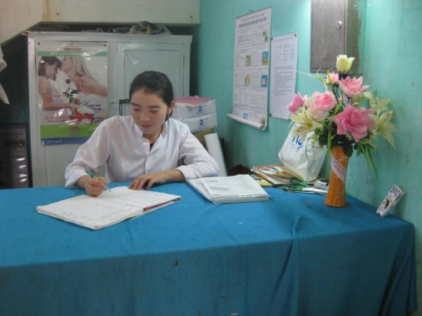
Opinion Leaders
Human health care workers, animal health workers and local government officials
Opinion Leaders

Slide 32
Opinion Leaders: Snapshot
Mindset
Sophisticated
Well educated
Family-oriented
Optimistic
Role in Community
Management of activities related to human and animal health.
Activities include: vaccination, quarantine, training and communication.
Community Status
Their status in the community is high
Their income is high and stable
They have a high sense of satisfaction
Community Situation
Raising poultry is not the main industry in this region.
There were two households in the region that were affected by the epidemic in 2005, but since then they have not experienced any AI outbreaks.
Opinion Leaders

Slide 33
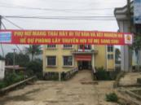
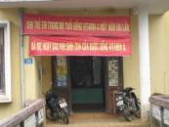
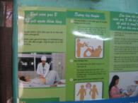
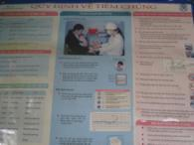
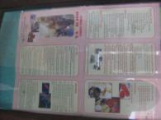
IEC Materials at the Medical Facility
Banners and posters at the medical facility cover many different diseases: parotitis vaccination, liver sickness, childhood vaccinations, malaria, etc.
But there’s no information about AI. According to the health workers, the citizens in this region are most concerned about malaria due to the area’s forest terrain.
Outside the building
Inside the building

Slide 34
Health Concerns of Opinion Leaders
Malaria is the leading health concern of opinion leaders. They believe that it is prevalent in this community due to its mountainous location with thick forests. This disease can be treated but takes a long time to cure.
Other health concerns were referred to as common diseases, including sore throat, common flu or cold, diarrhea, trachoma, and whooping-cough. These diseases occur frequently and affect both adults and children.
AI is a small concern. There have been no recent outbreaks, but there is still some level of concern as there is no cure and it can be fatal.
No. 1
Malaria
No. 2
Common diseases
No. 3
AI
Opinion Leaders

Slide 35
Relationship of AI to other Major Concerns
The opinion leaders are similar to farmers and contributors in terms of concerns:
Education leading to a successful career for their children is their main concern, followed by health. Having a healthy family means that there are no serious illnesses.
Household income and social concerns, including relationships with colleagues, friends and relatives, are also quite important.
Given their current positions in the community, healthcare is a priority:
For animal healthcare workers: congestion, New Castle, and AI are the main health concerns. Congestion and Newcastle occur more often in poultry, but AI is more serious as it can be transmitted to humans.
For human health care workers: the main health concerns are malaria, normal flu, petechial fever, and contagion. There was no mention of AI.
Education for Successful
Career
Health
AI
Economic
Social
Opinion Leaders

Slide 36
Health Belief Model (HBM)
Opinion leaders are at the third level of the HBM: Their misguided beliefs lead to barriers in prevention.
The government workers believe vaccination and quarantine programs are effective, but these programs potentially cause supply chain actors to become too relaxed about AI prevention.
Farmers almost have a blind trust in the vaccination program.
Contributors rely on the quarantine system.
HBM
AI is believed to be a threat
Yes
Triggers
Believe that AI can be avoided
Barriers
Communication
Yes
Triggers
Recommended actions are effective
No
Misguided beliefs
Boost motivation through influencers such as NGOs, HCWs, etc.
Yes
Triggers
Ability to take recommended actions
Opinion Leaders

Slide 37
Opinion Leaders’ Perceptions About AI
Healthcare workers
AI is seen as a serious threat because it can be transmitted to humans and cause death.
There is a difference in symptoms between normal flu and AI. For normal flu, patients may sneeze, have a runny nose or cough with phlegm. AI will result in respiratory problems and people should seek care within 48 hours.
They believe AI can be prevented by:
avoiding contact with sick poultry
reporting to local government if there is sudden and massive death of poultry
Local Government
There are many serious diseases that can cause massive deaths in poultry. These include congestion and Newcastle.
However, while AI is rare, it is the most serious disease because of the risk of transmission to humans.
Opinion Leaders

Slide 38
Past AI Prevention Initiatives
Human healthcare workers
During the outbreak in 2005, HCW moved all patients and their relatives to separate and remote schools for treatment and monitoring.
Currently, communication and education are the main prevention measures for AI. However, activities tend to be limited. Parotitis vaccinations, liver sickness, childhood vaccinations, and malaria are considered to be of higher importance and there is more information about these diseases at medical facilities and public places.
Animal healthcare & local Government
During the outbreak in 2005, the following activities were accomplished:
Testing for AI
Burning and burial of poultry with financial support provided to farmers
Disinfected areas within a 2-3 km radius
Collaboration with human healthcare workers to follow up on infected patients
Current activities include:
Quarantine all traded poultry
Government provided vaccinations for all poultry
Training courses to raise awareness
Provide educational materials about AI prevention
Opinion Leaders

Slide 39
Opinion Leaders’ Attitudes Towards AI Prevention
Human healthcare workers
AI is currently not a disease that is of top concern in this region. In the medical facility, there are many posters and banners about other diseases, but not AI.
Animal healthcare workers & local government
To keep AI under control, the local government have maintained these two activities:
Keep all traded poultry in quarantine
Provide vaccinations for all poultry in the region
The government is aware that farmers and contributors are not practicing preventive measures.
The local governments, if possible, would like to conduct a separate program on AI education on the radio and organize activities in the communities to raise awareness for AI prevention.
Opinion Leaders

Slide 40
Barriers to AI Prevention
Experience
For both farmers and contributors, a main barrier is lack of knowledge and experience.
With no recent outbreak in the region, AI is not a priority. Preventive measures are in place for other diseases to a certain degree, but not specifically for AI.
Vaccinations
Farmers believe that vaccinated chickens cannot be infected. This leads to complacency.
Quarantine
On the other hand, contributors trust in the quarantine system set up by the government. The belief is that chickens that are quarantined cannot be infected with AI.
Opinion Leaders

Slide 41
Potential Triggers for Behaviour Change
Communication
More communication in mass media, on TV and radio, is needed to raise awareness about AI prevention methods beyond vaccinations. There is a need to emphasize the potential impact of AI and the risk of future outbreaks.
Knowledge
It is necessary to change perceptions of both farmers and contributors regarding vaccination and quarantine of poultry. Vaccinated poultry still face a limited risk of AI infection and quarantined poultry can be exposed to AI during transport.
The key message needs to be modified: “vaccinated and quarantined poultry” does not mean there is no threat of AI.
Opinion Leaders

